Slide 1



NCL Steering Committee
Project Update
and Strategic Review
November 2025

Slide 2
Meeting Agenda
01
02
Progress recap
Key observations and recommendations
03
04
Plan for the month ahead
Golden process alignment
05
06
Innovation opportunities
Feedback and discussion

Slide 3
Progress Recap
SnowflakeML environment validated and configured
Source system connections established (Prospect, Guest, Booking)
Initial MLOps framework drafted (Git branching, CI patterns, job orchestration)
Feature store blueprint designed with priority features identified
Model inventory completed across Marketing, Revenue, and Operations
Migration approach finalized (R to Snowpark Python/Snowflake ML)
Golden process alignment sessions completed with DS and DE teams
Key accomplishments achieved to date:

Slide 4



Environment Observations and Recommendations
What we're seeing:
Areas of concern:
Recommended actions:
Fragmented R codebase with inconsistent structures
Legacy R packages incompatible with SnowflakeML
Standardize feature logic within the Snowflake Feature Store
Feature logic duplicated across tables and scripts
Missing lineage documentation slowing migration
Implement role-based access control across environments
Manual refresh processes limiting retraining cadence
Ambiguous model ownership for three marketing models
Document model metadata and lineage
Access permissions not aligned with RBAC best practices
Confirm ownership and SME for each Tier 1 and Tier 2 model

Slide 5

Key Observations
The Challenge
Misalignment across data architecture, warehouse usage, and governance slowing ML migration.
Data architecture:
Schema inconsistencies limiting reproducibility
Need to shift toward bronze–silver–gold structure
Resource utilization:
Warehouse sizing shows overprovisioned dev environments
Opportunity to reduce compute costs by 25–35 percent
Governance and security:
RBAC taxonomy incomplete
Model approval workflow not consistently followed
Model card and risk-tiering not yet embedded
ML Operations Foundations
+
+
Execution Foundations
Standardized data layers
Governed architecture
Consistent access control
Unified model lifecycle

Slide 6


Model Inventory Summary
Priority Model List
14
6
Einstein Contact Models (RSSC & OCI)
Status: In Progress
Total Models
Priority Models
(Out of 14)
Prospect Sales
Current Focus:
Einstein Contact Models (RSSC & OCI)
Guest Upsell Propensity
Revenue Forecast
Risk Tier Breakdown
Cancellation Propensity
Tier 1
Migration Status
2 Models (High Risk)
Discovery
Completed: inventory and scope finalized.
R-to-Python translation
Tier 2
Completed for Einstein models.
8 Models (Medium Risk)
Business logic validation
Upcoming: business logic and outputs verified.
Tier 3
Feature alignment
In progress: align features and interfaces with platform.
4 Models (Low Risk)
Deployment
Upcoming: rollout to OCI environments and monitor.

Slide 7
Month-Ahead Project Plan
Week 1–2
1
Finalize CI/CD pipelines for training and scoring
Set up initial feature store tables
2
Week 3–4
Refactor two R models to Snowpark-compatible versions
Automate model training workflows
Implement monitoring dashboards (performance + drift)
Week 5–6
3
Complete validation pack for first migrated model
Move migrated models into staging
System stabilization and performance tuning
Finalize Golden Process v1 documentation

Slide 8





Golden Process Framework
Intake
Structured request intake
Clear success metrics
Model risk classification
Development
Refactoring R models into Snowpark Python
Integrating features into the feature store
Version-controlled workflows
Testing
Statistical validation
Drift analysis
Model card creation
Deployment
CI-driven promotion
Rollback strategy implemented
Model registry tagging and lineage tracking

Slide 9
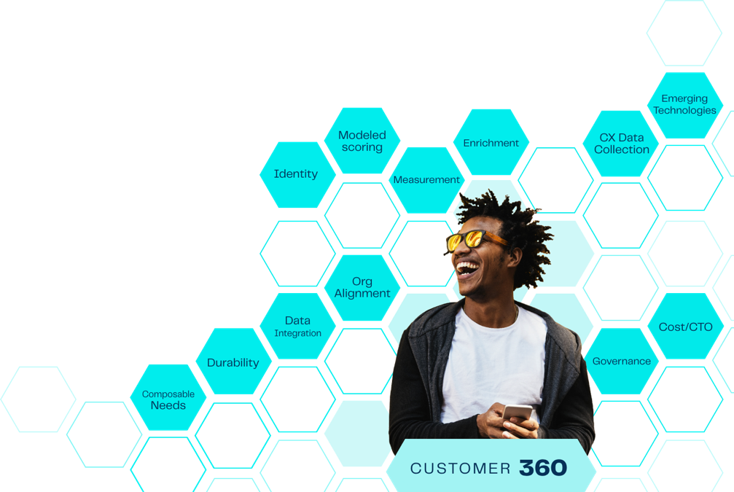




Innovation Opportunities
Feature Store
Centralizing feature logic to improve reuse and auditing
Dynamic Tables
Snowpark Container Services
Support for custom R logic and hybrid runtimes during transition
Snowpark Container Services
Dynamic Tables
Automated data refresh and retraining triggers
Feature Store
Cortex AI
Innovation
LLM-powered applications for guest personalization and content analysis

Slide 10



How Are We Doing
88%
90%
94%
On-time delivery
Stakeholder satisfaction
Quality metrics
Slight delays due to environment access approvals
Strong cross-team alignment and responsiveness
All completed components meeting standards

Slide 11




Next Steps
Confirm sequencing of priority model migrations
Finalize RBAC roles and permissions
Approve CI/CD environment changes
Schedule feature store deep-dive with DS and DE teams

Slide 12

©
Open Discussion
What's working well?
Where should we deepen focus?
Any blockers requiring SteerCo support?

